Slide 1
What I Learned From Cancer

Slide 2
The Bottom Line
There is often a difference between reality and truth.
Reality may be:
Disease
Depression
Financial worries
Challenging relationships

Slide 3
Diagnosis May 2013

Slide 4
“You’re so….”

Slide 5
Steve and Lorraine Box

Slide 6
Truth #1
I am an inspiration!

Slide 7
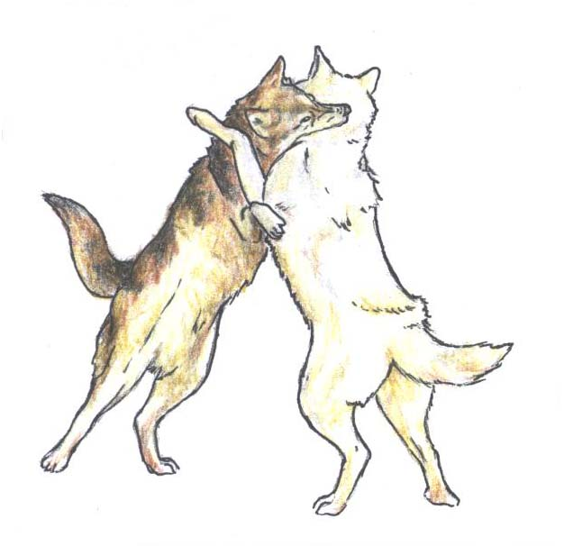
Which wolf wins?
Darkness and despair
Light and hope

Slide 8
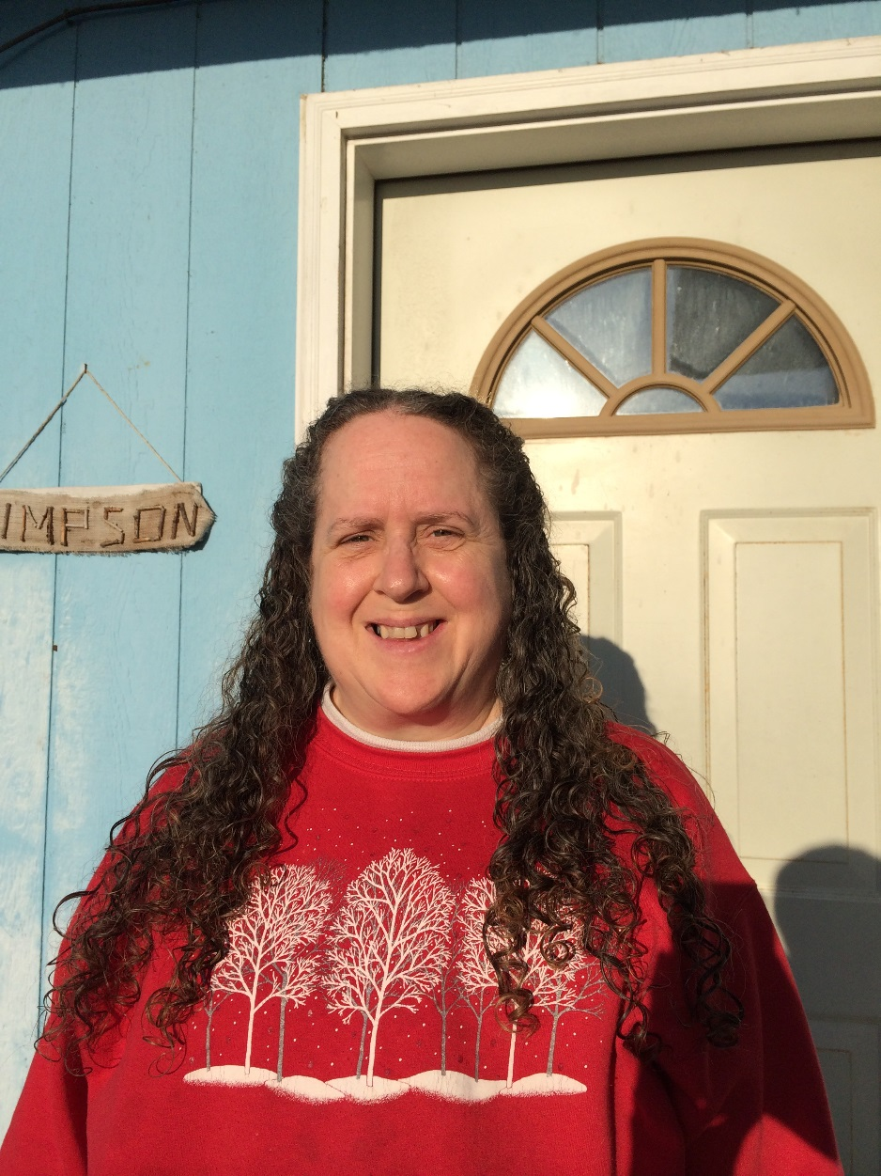
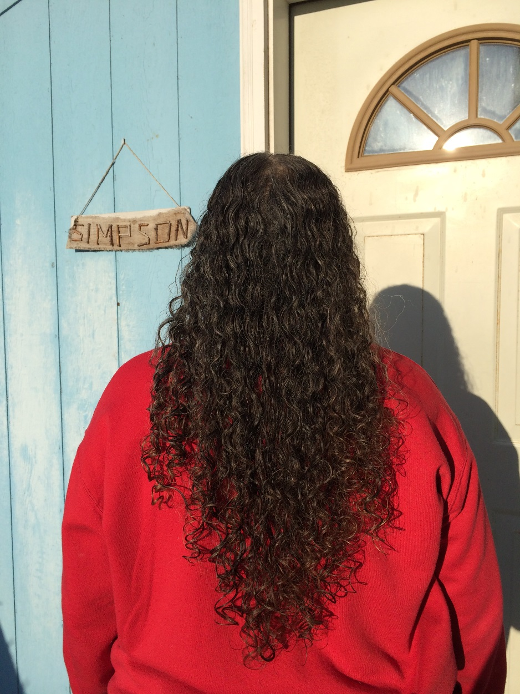

Slide 9
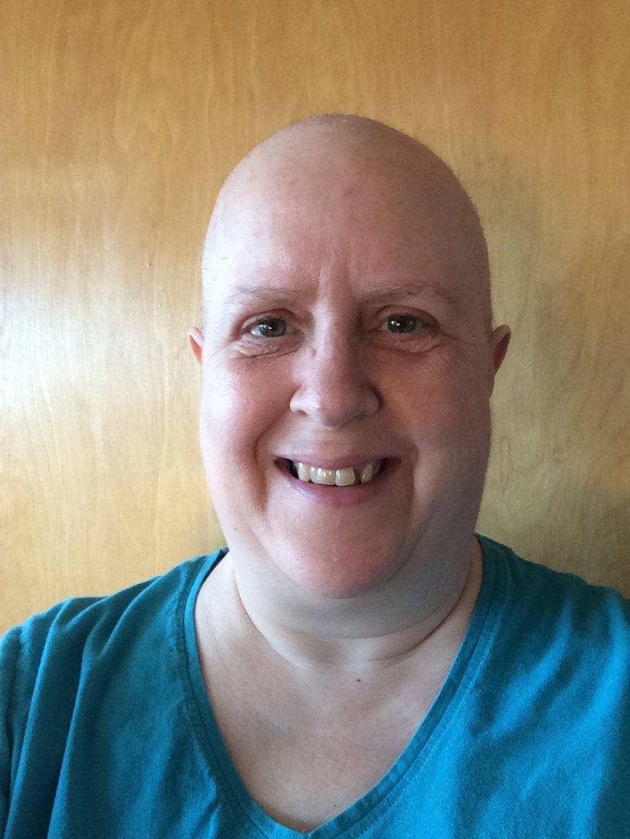
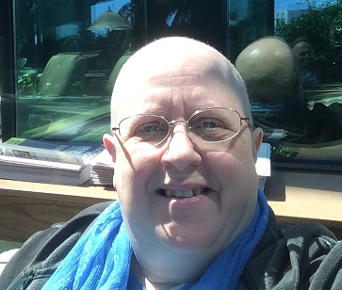

Slide 10
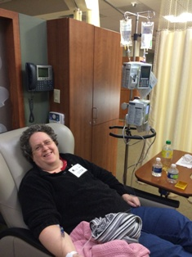
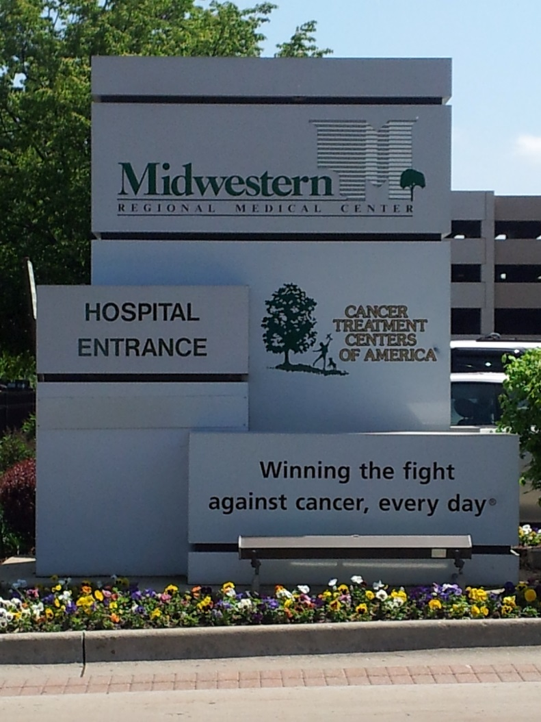
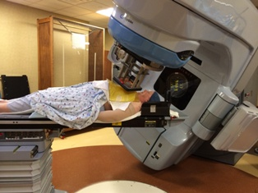
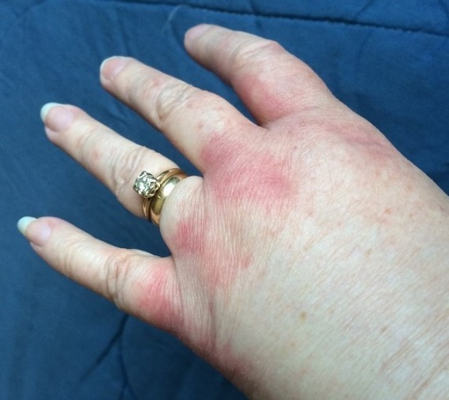
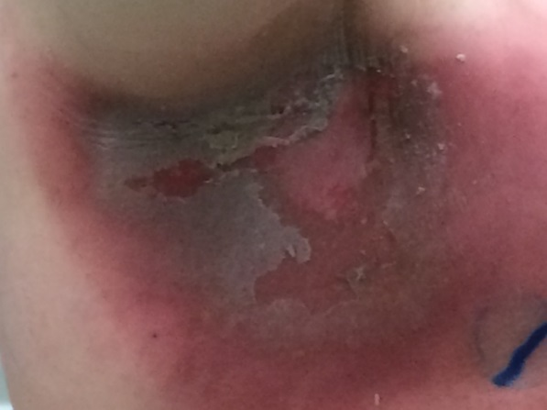
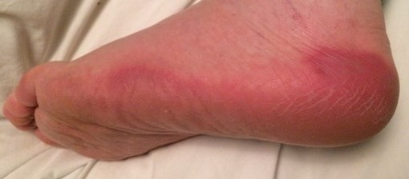
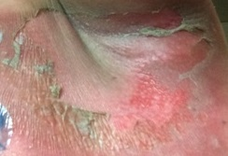

Slide 11
Flesh vs. Spirit
Gal. 5:17 For the desires of the flesh are against the Spirit, and the desires of the Spirit are against the flesh, for these are opposed to each other. (ESV)
Rom. 7:21-23 It happens so regularly that it’s predictable. The moment I decide to do good, sin is there to trip me up. I truly delight in God’s commands, but it’s pretty obvious that not all of me joins in that delight. Parts of me covertly rebel, and just when I least expect it, they take charge. (The Message)

Slide 12
Renew Your Mind
Romans 12:2 Do not be shaped by this world; instead be changed within by a new way of thinking. (NCV)
2 Cor. 4:16, 18 Therefore we do not lose heart. Even though our outward man is perishing, yet the inward man is being renewed day by day. ...We do not look at the things which are seen, but at the things which are not seen. For the things which are seen are temporary, but the things which are not seen are eternal. (NKJ)

Slide 13
Chris Hogan – One Lord Sunday, 4/19/15
“If you re-visit old hurt, it just does you new harm.”

Slide 14
2 Corinthians 10:3-5
We do live in the world, but we do not fight in the same way the world fights. We fight with weapons that are different from those the world uses. Our weapons have power from God that can destroy the enemy’s strong places. We destroy people’s arguments and every proud thing that raises itself against the knowledge of God. We capture every thought and make it give up and obey Christ. (NCV)

Slide 15
Shakespeare:
“Our doubts are traitors and make us lose the good we oft might win by fearing to attempt.”

Slide 17
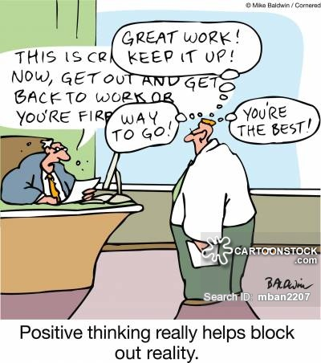

Slide 18
Truth #2
God loves me.

Slide 19
Jeremiah 31:3
The Lord has appeared of old to me, saying:
“Yes, I have loved you with an everlasting love;
Therefore with lovingkindness I have drawn you.”

Slide 20
Matthew 28:20b
“I am with you always, even to the end of the age.”

Slide 21
Romans 8:35,38-39
Who shall separate us from the love of Christ? Shall tribulation, or distress, or persecution, or famine, or nakedness, or peril, or sword?...I am persuaded that neither death nor life, nor angels nor principalities nor powers, nor things present nor things to come, nor height nor depth, nor any other created thing, shall be able to separate us from the love of God which is in Christ Jesus our Lord.

Slide 22
Truth #3
God is good, all the time.

Slide 23
Romans 8:28
And we know that all things work together for good to those who love God, to those who are the called according to His purpose.

Slide 24
Jeremiah 29:11-14a
For I know the thoughts that I think toward you, says the Lord, thoughts of peace and not of evil, to give you a future and a hope. Then you will call upon Me and go and pray to Me, and I will listen to you. And you will seek Me and find Me, when you search for Me with all your heart. I will be found by you, says the Lord, and I will bring you back from your captivity.

Slide 25
1 John 4:4b & Philippians 4:13
He who is in you is greater than he who is in the world.
I can do all things through Christ who strengthens me.

Slide 26
Truth #4
I have more faith in God’s goodness and character than I realized.

Slide 27
Deuteronomy 31:8
And the Lord, He is the One who goes before you. He will be with you, He will not leave you nor forsake you; do not fear nor be dismayed.

Slide 28
Isaiah 41:10
"Fear not, for I am with you; Be not dismayed, for I am your God. I will strengthen you, Yes, I will help you, I will uphold you with My righteous right hand."

Slide 29
Truth #5
Thankfulness develops a heart of praise and creates hope.

Slide 30
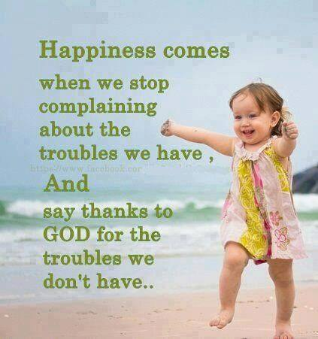

Slide 31
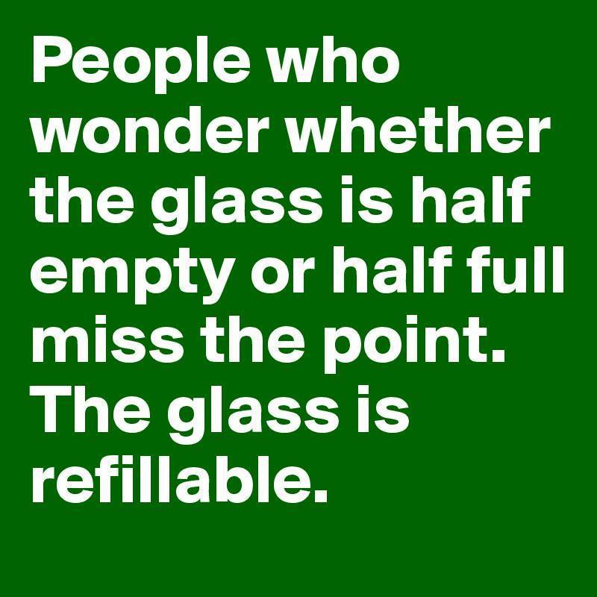

Slide 32
Truth #6
I can choose hope, thankfulness, truth, joy.
And you can, too.

Slide 33
The Four Temperaments

Slide 36
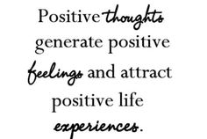
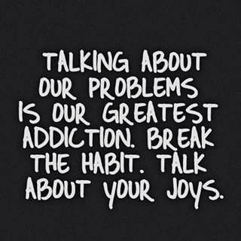

Slide 37
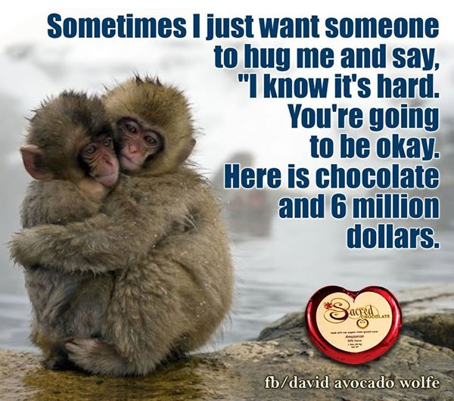

Slide 38
Remember…
God loves you.
God is good, all the time.
You can have faith in God's goodness and character.
Thankfulness develops a heart of praise and creates hope.
You can choose hope, thankfulness, truth, joy.

