Slide 1
Barb Iman
Update 11/16/2016

Slide 2
Cyprus

Slide 3
TURKEY
Iraqi Kurdistan
(Southern Kurdistan)
Kurds generally consider it to be one of the four parts of a Greater Kurdistan, which also includes parts of southeastern Turkey (Northern Kurdistan), northern Syria (Rojava or Western Kurdistan), and northwestern Iran (Eastern Kurdistan).
IRAN
SYRIA
IRAQ

Slide 4
Frontier Alliance International: www.faimission.org

Slide 5
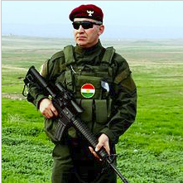
Peshmerga
Kurdish fighters in northern Iraq
Name translates to “those who face death”
Responsible for defending the land, people and institutions of the Kurdistan Region
Played a key role in capturing Saddam Hussein
Fight Islamist militants of the Islamic State (ISIS)

Slide 6
Mosul: Nineveh ruins (capital of Assyria)

Slide 7
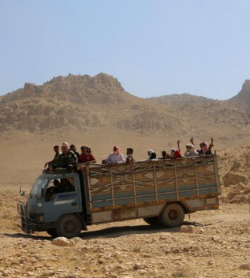
Kurdistan

Slide 8
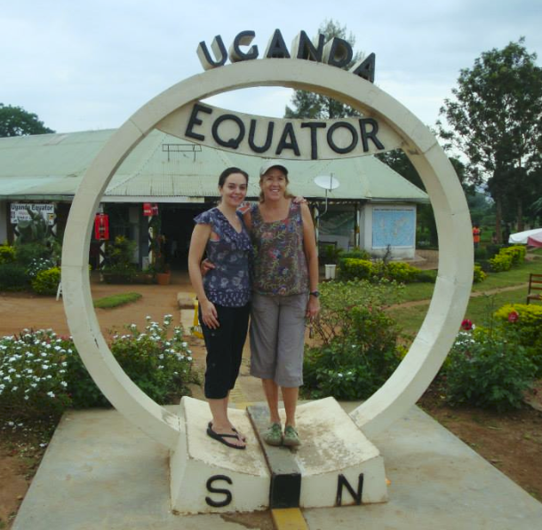
Barb in Uganda

Slide 9
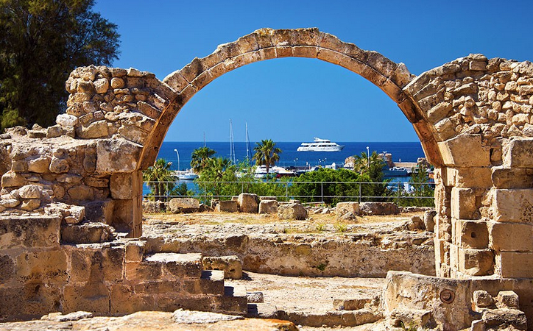
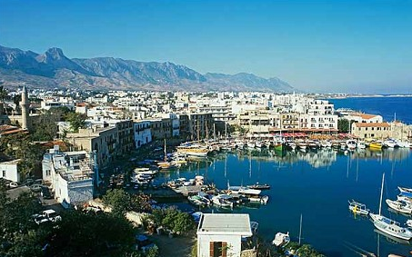
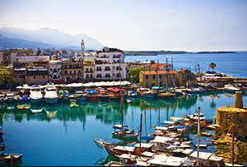
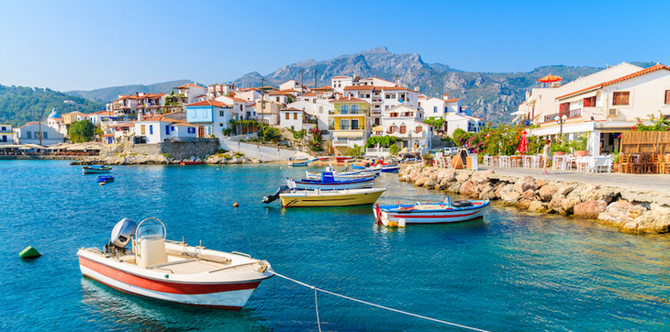
Cyprus

Slide 10
Isaiah 19:23-25
In that day there will be a highway from Egypt to Assyria, and the Assyrian will come into Egypt and the Egyptian into Assyria, and the Egyptians will serve with the Assyrians. In that day Israel will be one of three with Egypt and Assyria—a blessing in the midst of the land, whom the Lord of hosts shall bless, saying, “Blessed is Egypt My people, and Assyria the work of My hands, and Israel My inheritance.”

Slide 11
Erbil, Kurdistan

Slide 12
Contact and/or Donate
imaninafrica@gmail.com
Tax deductible donations can be sent to
Iris Global
P.O. Box 493995
Redding, Ca. 96049-3995
Or give online at irisglobal.org/giving-center

